Slide 1



OMS Tips & Tricks
Leverage OMS For You

Slide 2

MOVING CASES
Forcing Downstream
Missing Device
Erroneous Call(s)
Partial Restore
Forcing Partially Upstream
Ensuring Data Transfers
Bringing Missing Device Information in to GIS
Notes:
Welcome to the OMS Tips & Tricks block., designed to show you how to manage unusual outages with special circumstances; for example, when you have an upstream outage and there is a partial restore in stages downstream as power is restored over time. Or when you have a missing device that causes an over prediction, in addition we will cover how to get missing devices information to GIS to add in to the map database.
[CLICK] We’ll then progress through moving a case by forcing downstream using several techniques to accomplish this. We will also discuss the various reasons why you would need to do this such as:
[CLICK] When you encounter an instance when you over predict due to a Missing Device.
[CLICK] We’ll cover special circumstances where you may find that there are erroneous calls in the OMS system causing an over prediction.
[CLICK] And we will round out our discussion with performing a Partial Restore and moving a case back downstream piece-meal to accurately reflect conditions in the field.
[CLICK] Moving through the progression, we’ll cover how to force the case back upstream to the actual device that is out such as when using the Verify option to push a case downstream and it moves too far downstream.
[CLICK] We will cover how to ensure data transfers over to the new outage such as, notes, comments, assignments, and calls.
[CLICK] And finally, we will discuss how to bring missing device information over in to GIS.

Slide 3

Forcing Downstream
Missing Devices
Erroneous Call(s)
Partial Restore
Notes:
We all know this guy, good ole’ Charlie Brown, always striking out. Sometimes, even in OMS we can strike out let’s see what we can do about it if it happens to us.
We can force an outage that has been predicted on an upstream device that has gone too far upstream due to; a missing device, erroneous calls, or a partial restore. What do we mean by each of these scenarios?
[CLICK] In a situation where OMS predicts too far upstream but the lineman notes that there is a device downstream actually in the field, we have what is referred to as a Missing Device. Since OMS derives all information from your enterprise GIS system this means that GIS does not have a device that exists in the field or an update has not captured this new information. This can be corrected but would require GIS edits and a new OMS Update which does not help you as a Dispatcher during an outage.
[CLICK] Erroneous Calls occur when a CSR or CRC or some other integration input enters a call in to OMS but it is at the wrong location. A likely scenario would be where a call taker looks up a record for a customer but does not realize nor checks if they have multiple accounts and enters the wrong account location. In some instances this could be the difference between Prediction Logic placing the outage on a downline Fuse and pushing it up to an OCR. Usually, the lineman would report the discrepancy to dispatch and notify the dispatcher which device is actually out.
[CLICK] The final instance where we would want to push downstream manually involves a staged partial restore. These are usually after a major outage has occurred and power is being slowly restored in the field as access to the infrastructure is available to the linemen. This is one of the more complicated situations but with a little practice it becomes much easier to perform.
Lets break each one of these down and unpack the process required for each.

Slide 4
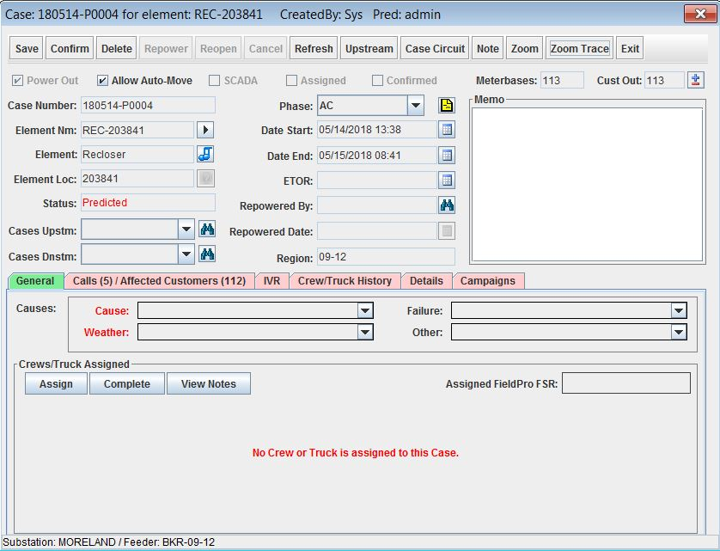
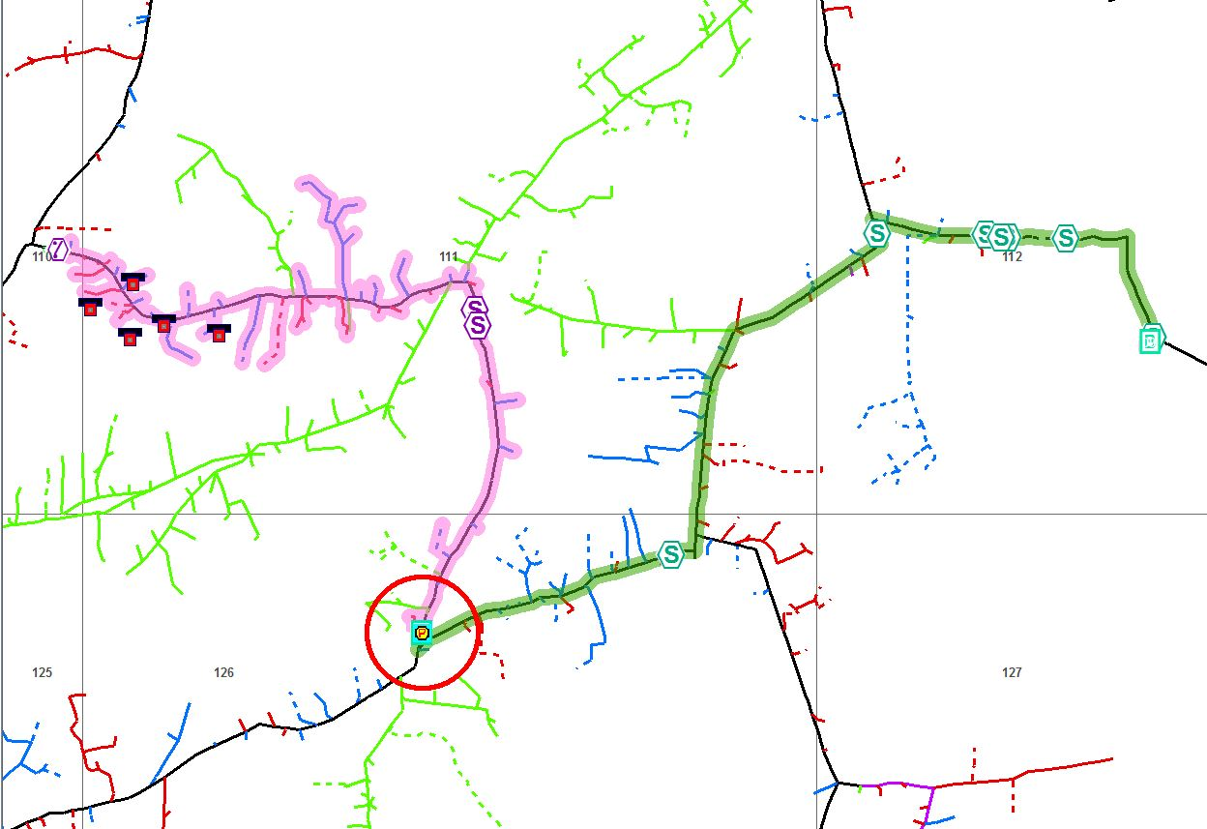
Missing Device
Notes:
Consider the following:
[CLICK] A case gets built in OMS and you assign a crew that is in the area. This Case is on a Recloser (or OCR) but only has two phases out and five calls in for a total of 112 consumers out.
[CLICK] We perform a ZoomTrace to get a good look at the outage and it becomes obvious that something is off we have:
[SHOW WITH HI-LIGHTER ON SCREEN]
A pretty tight cluster of five calls way down near the bottom of this trace.
And an upstream Recloser that is being predicted as being out.
Because we are in the office and can only go on what information we have we will need to wait on this case and let it set as a Predicted case until the lineman tells us otherwise. However, it may be a good idea to let the lineman know what you are seeing in order to help identify the actual trouble area faster.

Slide 5
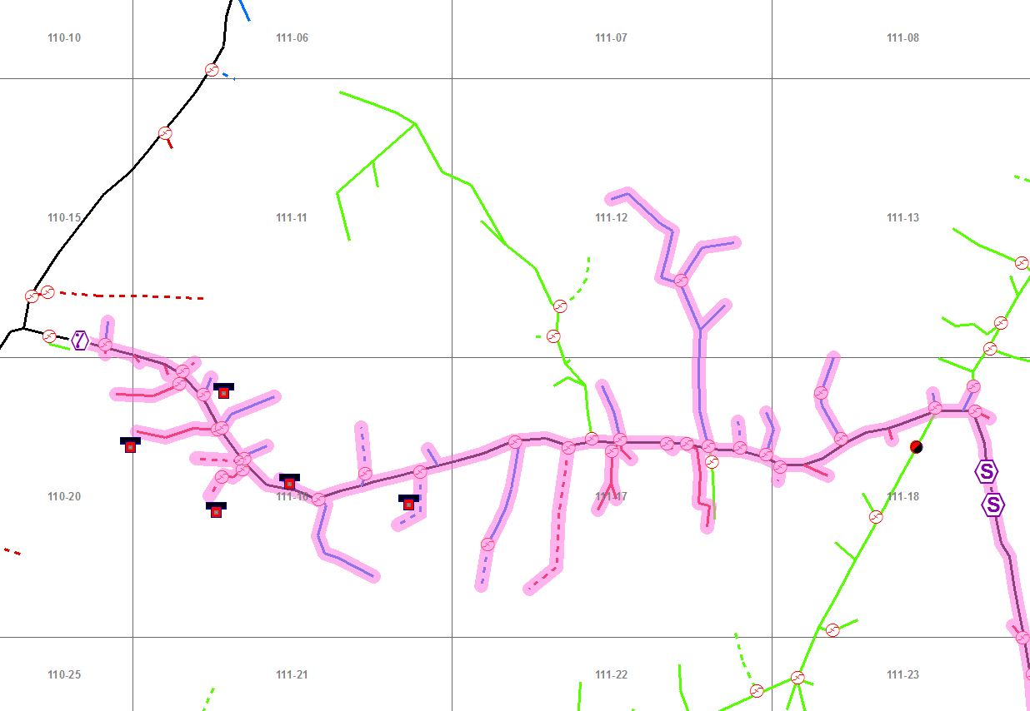
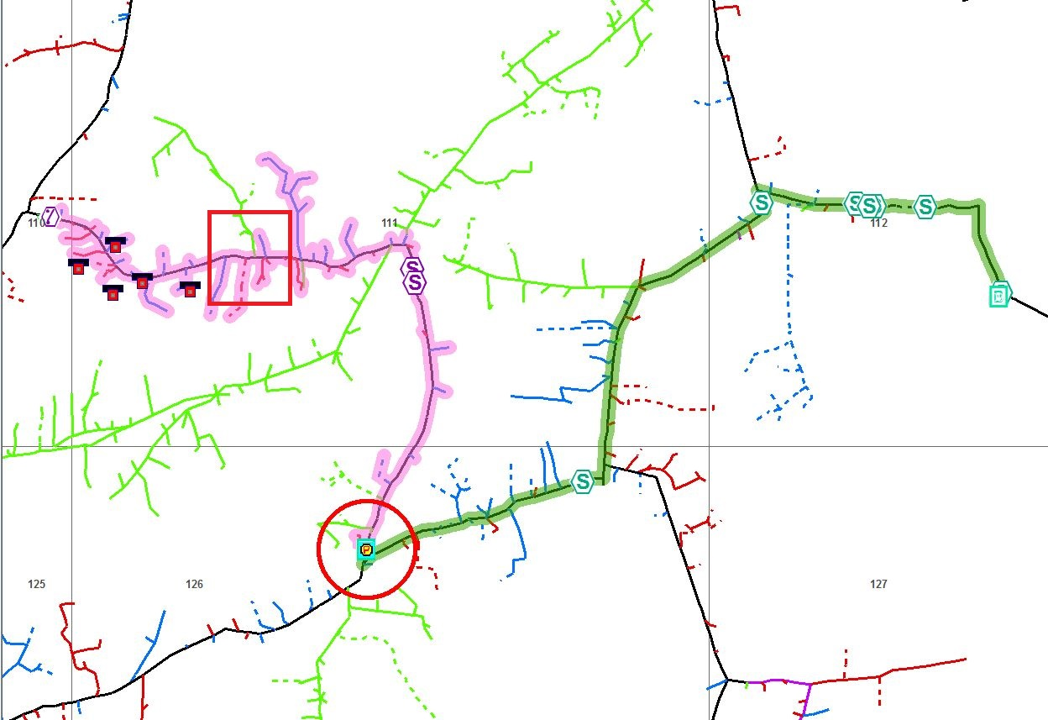
Missing Device
Notes:
[CLICK] Once the lineman gets on-site he determines that the Recloser is fine and starts to run downline to identify the device that operated.
[CLICK] The lineman identifies a downline tap fuse that is missing here.

Slide 6
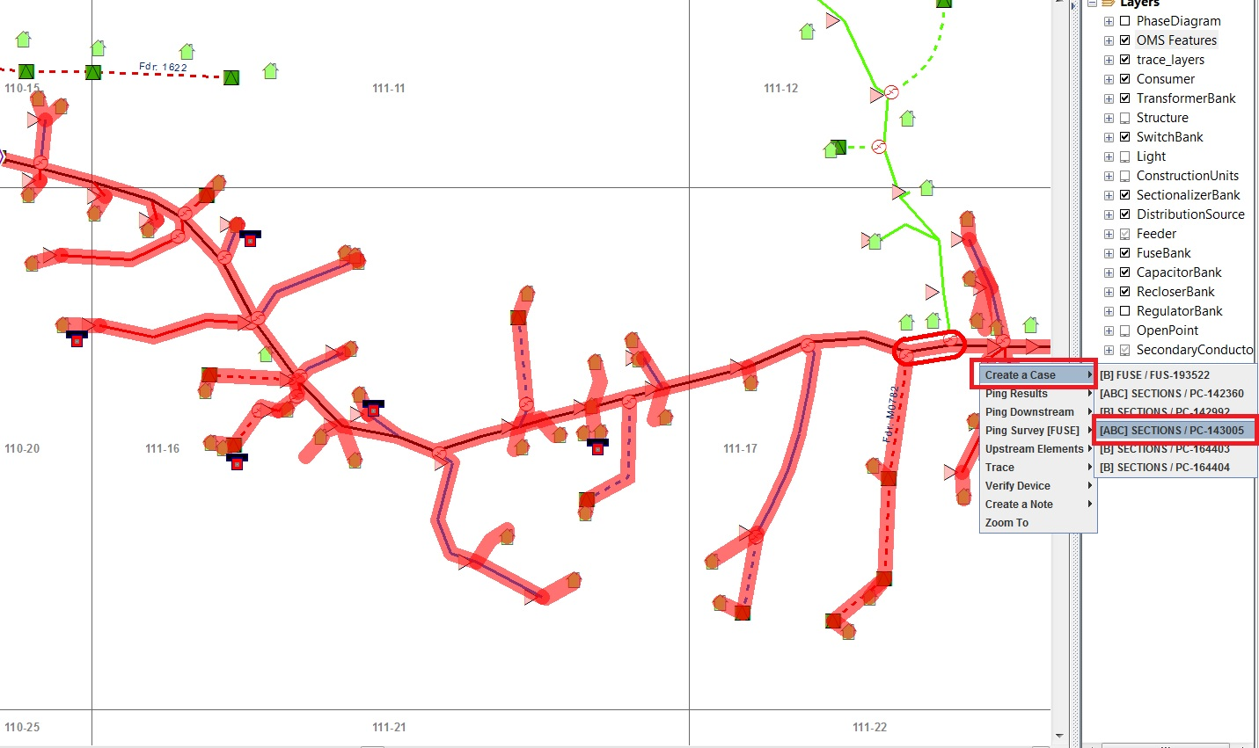
Missing Device
Notes:
[CLICK] Once we know were the missing device is located we can Confirm the upline Case on the Recloser to lock it in.
Then we can [CLICK] create a new case downstream of the original Recloser case on the line section the lineman identifies for the missing fuse.
Using the Right-Click menu item we can select the line section and then.
Create a Case option which will give us all potential features we can place a case on.
For our purposes we will put a case on this line section in red.

Slide 7
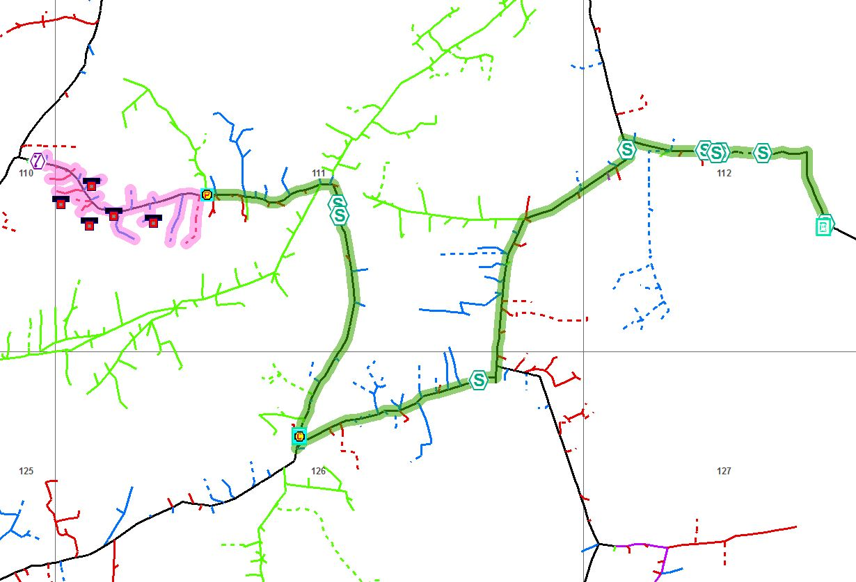
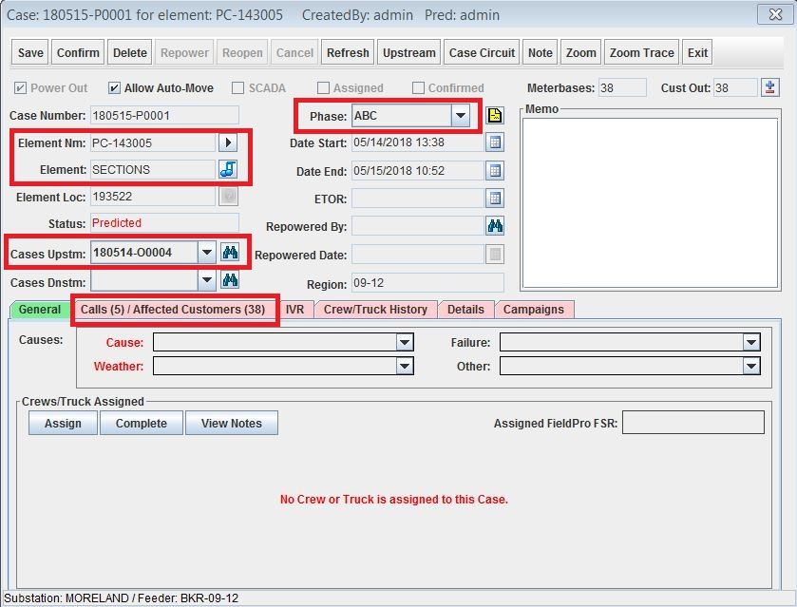
Missing Device
Notes:
[CLICK] Here we can see the ZoomTrace of the new downline case placed on a line section to represent the missing fuse.
[CLICK] Once we open the Case Ticket we can see that we have;
[SHOW USING HI-LIGHTER]
The Element name and the element to show that this case is on a piece of Primary.
We can see that there is an existing Case Upstream from this one, this case would be the original Recloser Case.
The Calls are still at five but the Affected Customers predicted out is significantly lower than the original 112 at 38 now.
Finally, we see that this case is predicted on all three phases but the original was only on two phases (A and C).

Slide 8
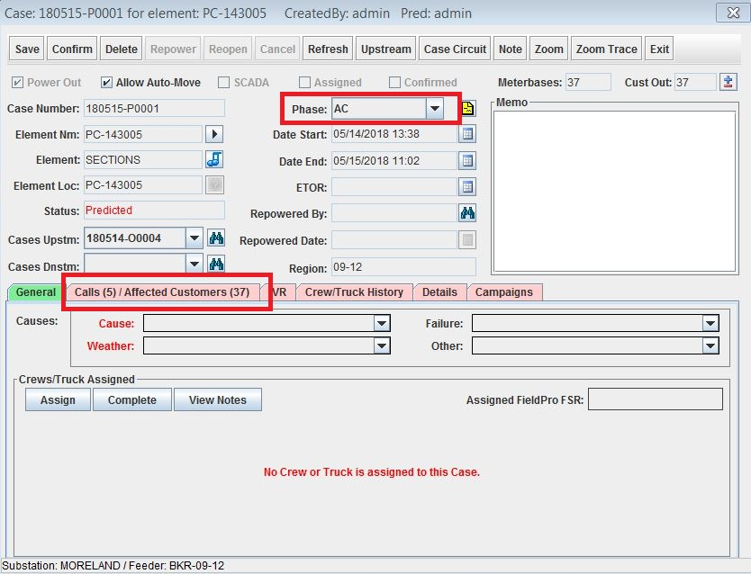
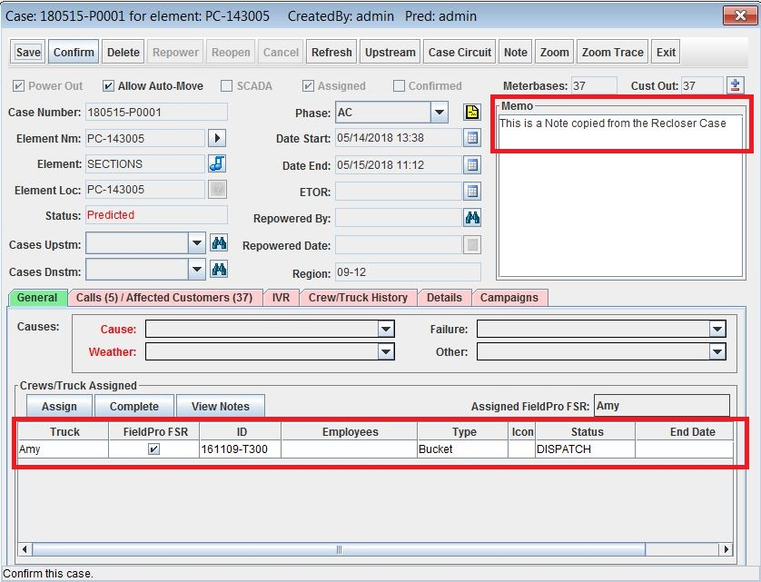
Missing Device
Notes:
[CLICK] We will have to adjust the phasing to reflect the original case by using the Phase pulldown and selecting the original case phasing.
We see that the total customers predicted out went down by one customer from 38 to 37.
[CLICK] Now we will want to Restore the original upline Recloser case leaving only the downline Fuse case.
We will want to copy over any Notes from the Memo field and ensure that the Assignment is correct or recreate the assignment.
At this point you would work this outage like any other that you normally do.

Slide 9
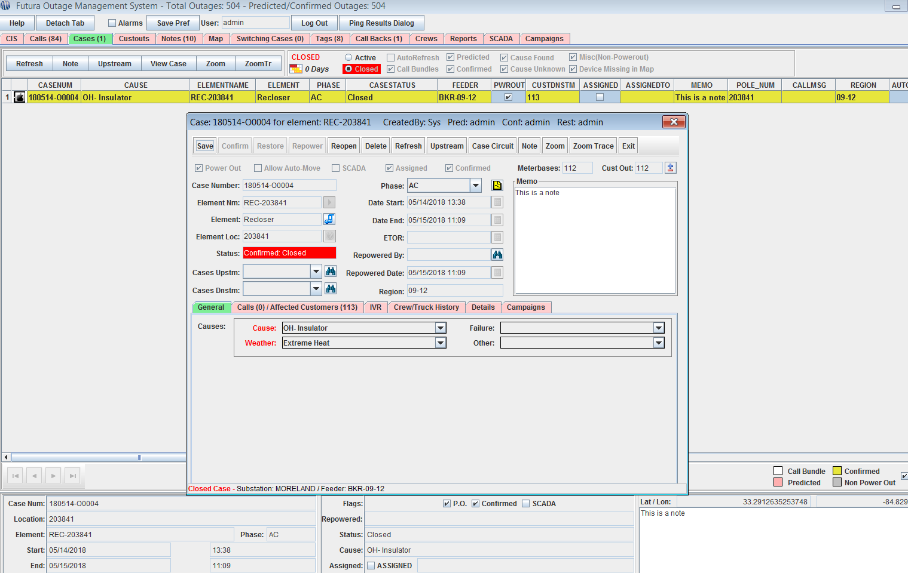
Missing Device
Notes:
There is one piece that is left to do:
{CLICK}
You should go in to your Cases and Delete the original case so that the numbers calculate correctly.
Please think about what you are doing when performing this operation so that you delete the correct outage.

Slide 10
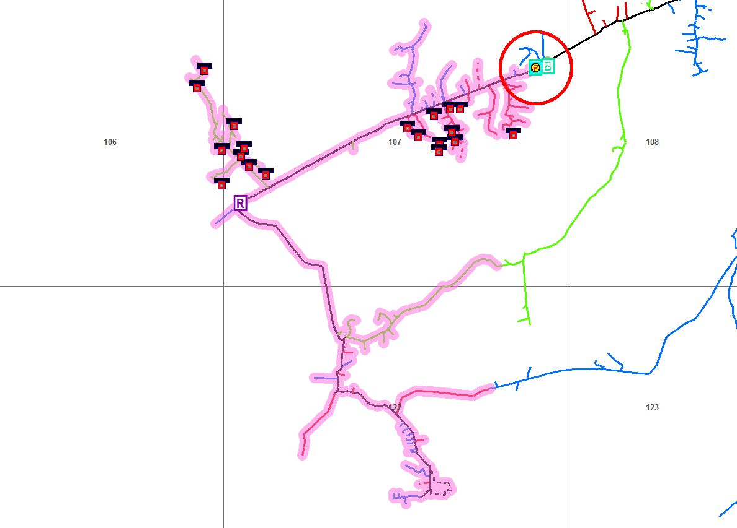
Erroneous Call(s)
Notes:
There are times when you will dispatch to a device and the Prediction looks to be somewhat sound. Yet when the lineman gets on-site he notes that the predicted device is closed at the moment. Once the lineman drives down the line they find an open device a bit downline.
What happened?
[CLICK] There could be erroneous calls placed in OMS. This happens sometimes with an AMI mesh network system when using an auto reporting configuration. These calls ……………..
[SHOW USING HI-LIGHTER]
…………..are actually bogus and are false readings from an AMI system.
OMS will not reject information that comes in to the system from integration vendors’ systems. Thus, as far as OMS is concerned this scenario is quite legitimate. Yet the outage is actually ………….
[SHOW USING HI-LIGHTER]
…………. Much father downline in this area.
Another instance that is not as severe would be a Call Center picking the wrong meterbase location due to multiple accounts under the same name and not getting the correct one.
How do we square up OMS with what is actually happening in the field so that our reporting numbers are as accurate as possible?

Slide 11
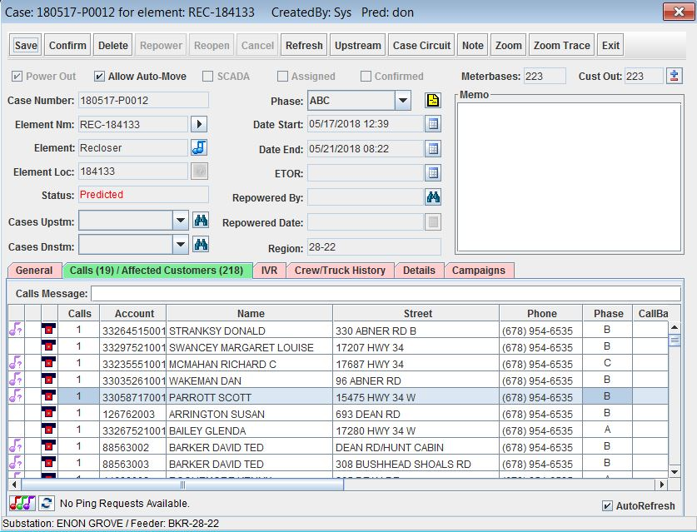
Erroneous Call(s)
Notes:
Once we open the Case Ticket we can see that there are 19 calls within this case mixed on each phase, A, B and C. We are showing a total of 218 consumers out with the trouble device on a three phase Recloser.
[SHOW WITH HI-LIGHTER].
We can go ahead and assign a crew to that Recloser and wait for the lineman to report back. We have no other option at this point unless we have an AMI system. Then we could ping the meters involved in this out to confirm these calls are actually out of power.

Slide 12
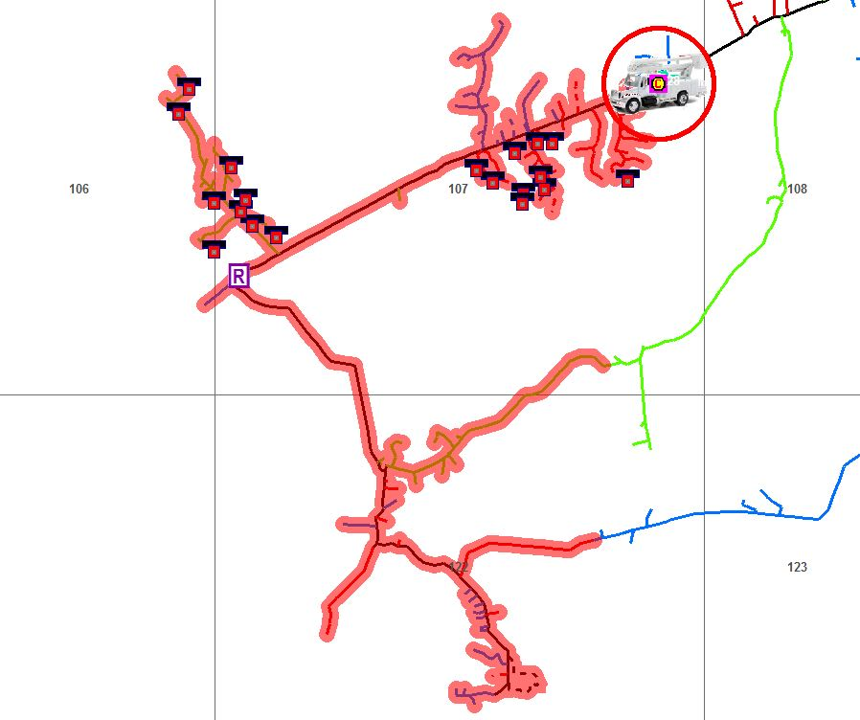
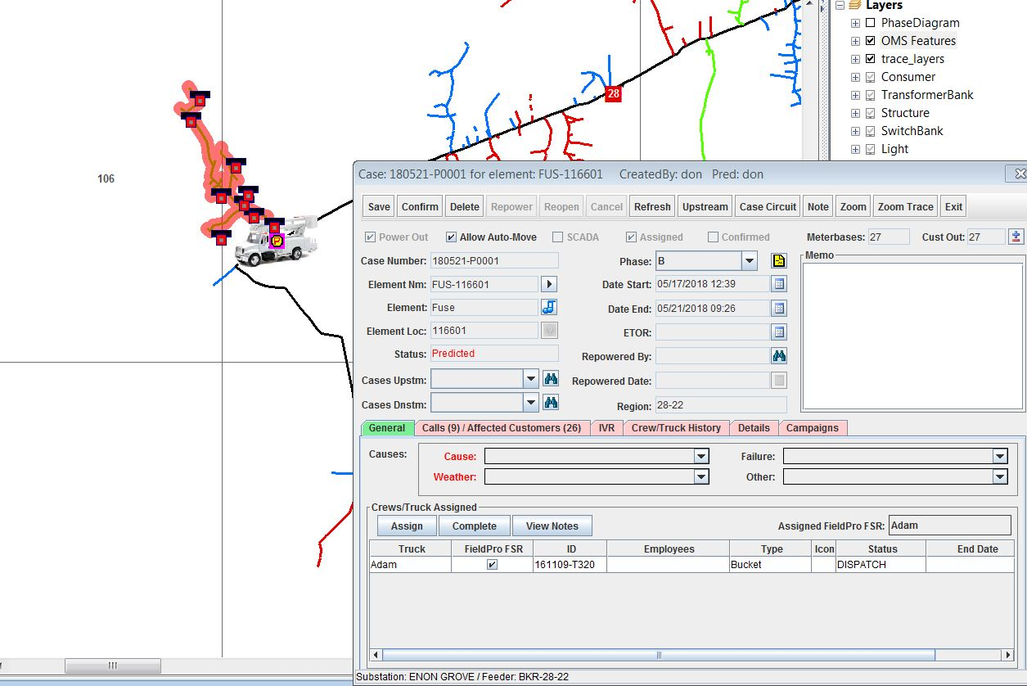
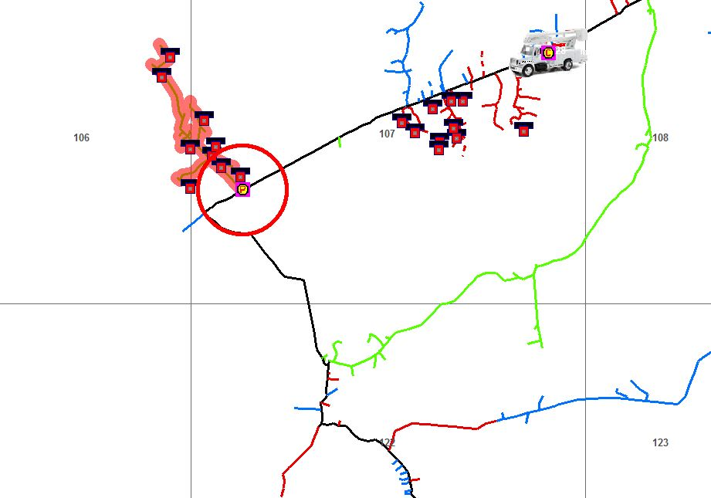
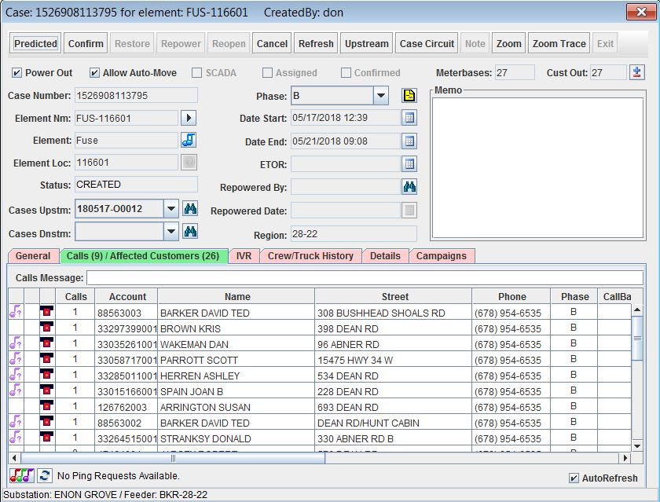
Erroneous Call(s)
Notes:
[CLICK] For the purposes of this training today we will assume that we have pinged the meterbases in this outage case and only the downstream calls are valid.
[SHOW WITH HI-LIGHTER].
We will want to move the case back downstream to be only on the B phase.
Running a trace from one of the downstream meterbases I am able to determine that there is a tap fuse just upstream from this cluster of downline calls. We can go ahead and build a case on this Fuse. Once we have the case built we can note that we now have 9 calls associated with this outage case. Further we now see that we have 26 Affected Customers all of B phase for this case.
[CLICK] Running a trace we can now see that we have a new Predicted case downstream of the larger Confirmed case.
[CLICK] Now all we have to do is to copy over any Memo field information, assignments, and Calls Notes if present. Then we can restore the upline case putting a note to Delete this outage after the fact.
[CLICK] Now we can see the trace of the resulting outage case on the Fuse and that the original Recloser case upline has been restored. The truck has been moved to the new Fuse case as we can see here.
[SHOW WITH HI-LIGHTER]
Discuss the moving of the case from the upline to the downline outage.

Slide 13
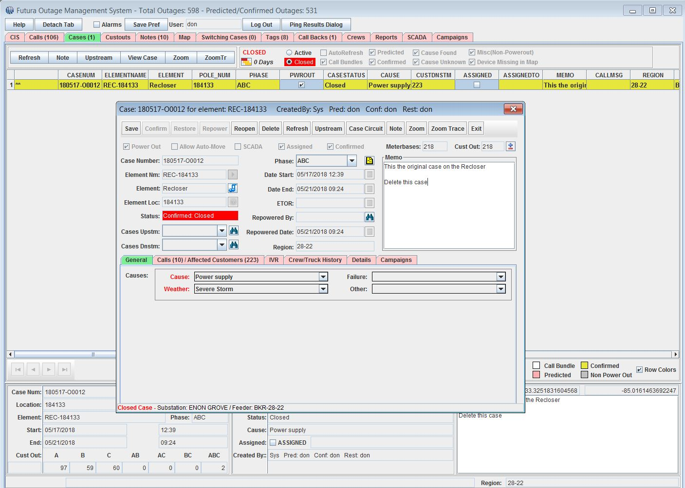
Erroneous Call(s)
Notes:
We now move over to the Cases tab {CLICK} and set to view Closed Cases as we can see here [CLICK].
[CLICK] We can view the memo area here and copy out what we need from this window.
[CLICK] Then we can delete this Closed Case
[SHOW WITH HI-LIGHTER] Discuss the entire process.

Slide 14
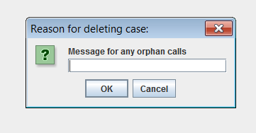
Erroneous Call(s)
Notes:
You will likely get a pop-up message {CLICK} asking for a reason for any orphaned calls. You will type a message here and hit OK. These orphan calls are the remaining erroneous calls from the upstream case so you will want to note this in the message you enter here.
Now you can continue to work the corrected outage as usual from here on out, knowing that the overall customer count is accurate.

Slide 15
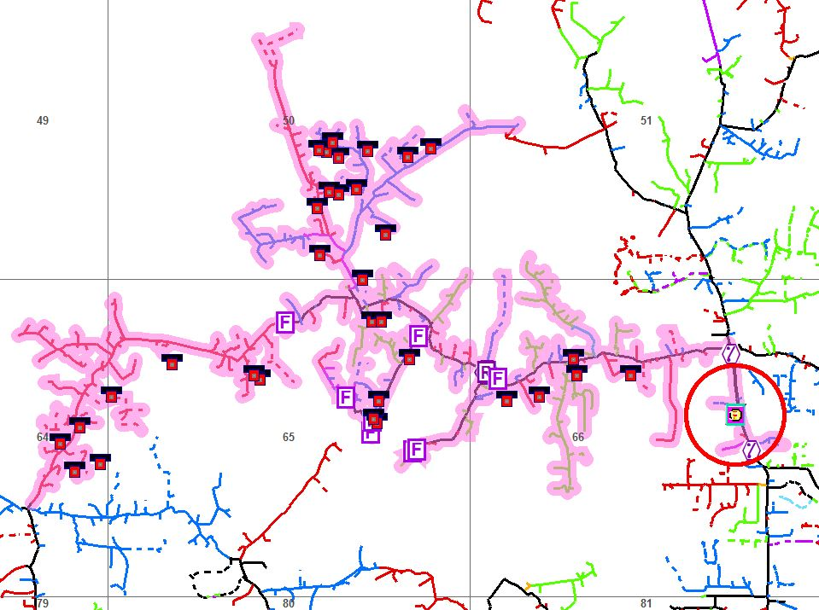
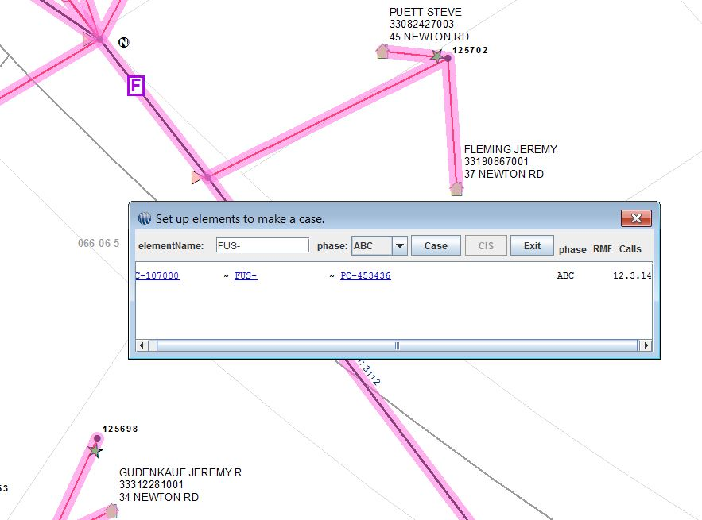
Partial Restore
Notes:
As we discussed in the introduction to this block the final reason you may need to force an outage downstream is in order to accurately represent an on-going outage case that is restored over time piece by piece in real time. In other words, in a major outage situation there will be certain upline devices that will come back on-line in parts. This creates what is know as a Partial Restore and we will cover how to perform this operation as the linemen report back the devices that begin to come back up.
- [CLICK] Consider the following Case: We have a Breaker case with 33 Calls Predicting 848 Affected Customers out.
[SHOW WITH HI-LIGHTER]
Based on the trace above we can see that there is a main line 3 phase fuse here..[CLICK]
Imagine that the lineman calls back in on-site at the Breaker stating that they have the Breaker closed back in but the downline Fuse is now out.
[CLICK] We can zoom to the Fuse location after identifying and confirming the correct one and then create a case on that Fuse.

Slide 16
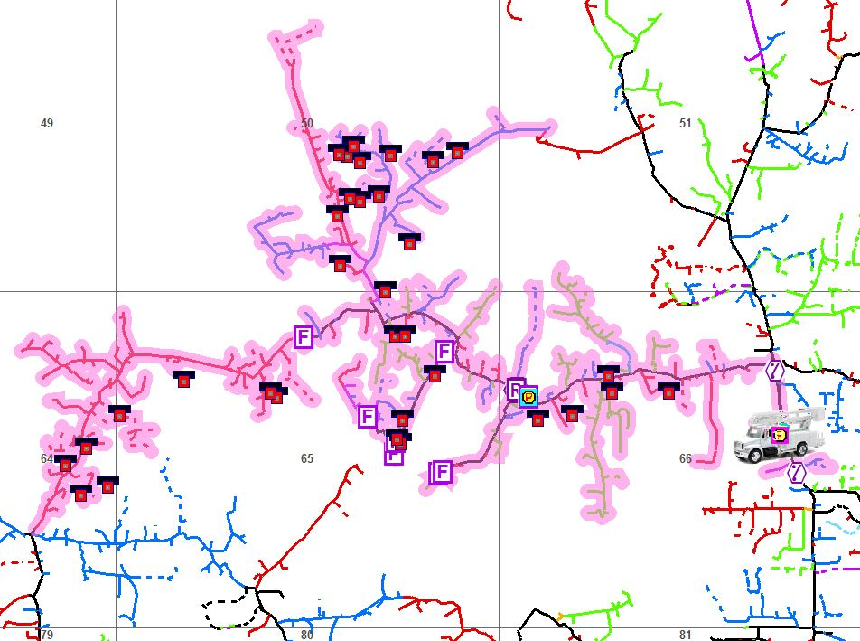
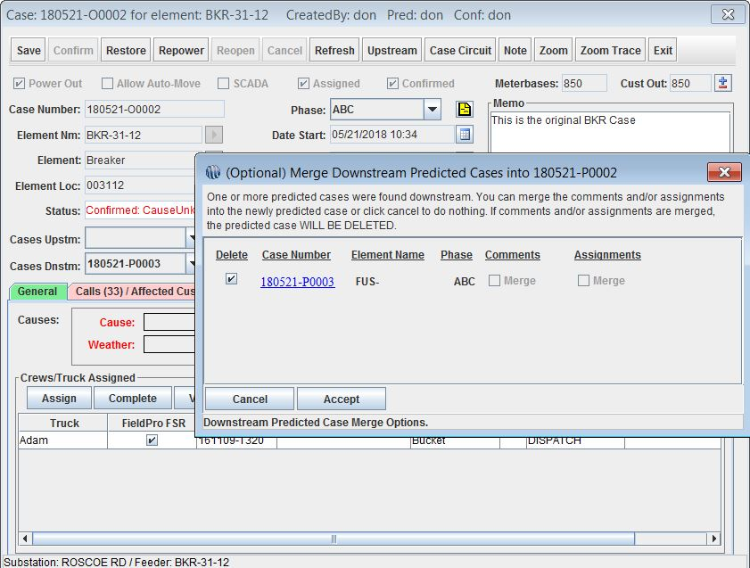
Partial Restore
Notes:
Now if we run a trace {CLICK} on the original Breaker case we can see both cases in line with each other.
[SHOW WITH HI-LIGHTER] – discuss the calls and how they fall within each case.
[CLICK] We will want to continue to work the original upstream Breaker case and so we will go ahead and Confirm it. We will get a pop-up asking if we want to merge the new downline case we just built on the Fuse. In most cases we would want to merge these cases to ensure we get all of the associated notes, assignments, and calls messages.

Slide 17
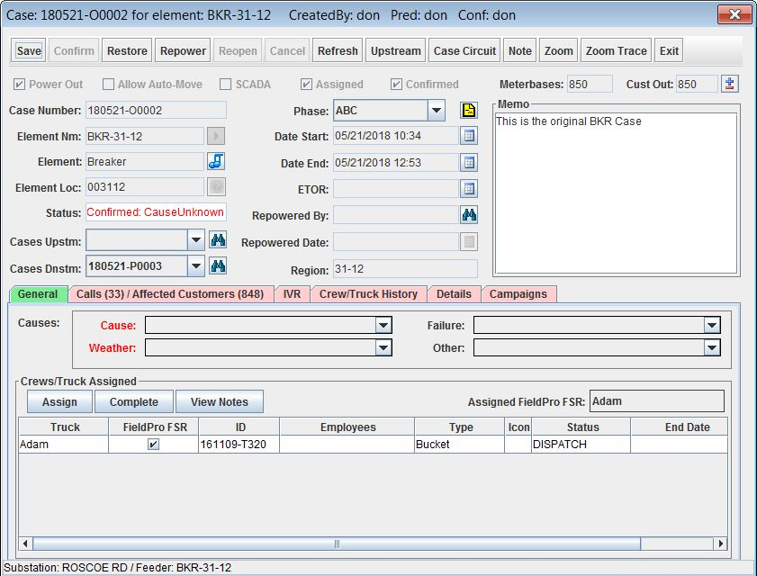
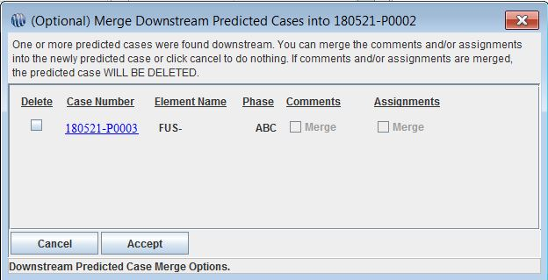
Partial Restore
Notes:
However, in this instance we will NOT want to merge these two cases and will want them to remain apart for one another.
So we will uncheck the check box for [CLICK] delete and then hit the Accept button.
Once we have Accepted no merge, we get [CLICK] a Confirmed upline Breaker case that we can now restore. But before we do we will want to make a note of the assigned [CLICK] crew, memo notes and calls message so that we can copy all of them over to the downline Fuse case we built earlier.
I should note here that if you use the merge option we saw earlier that these items will come over automatically.

Slide 18
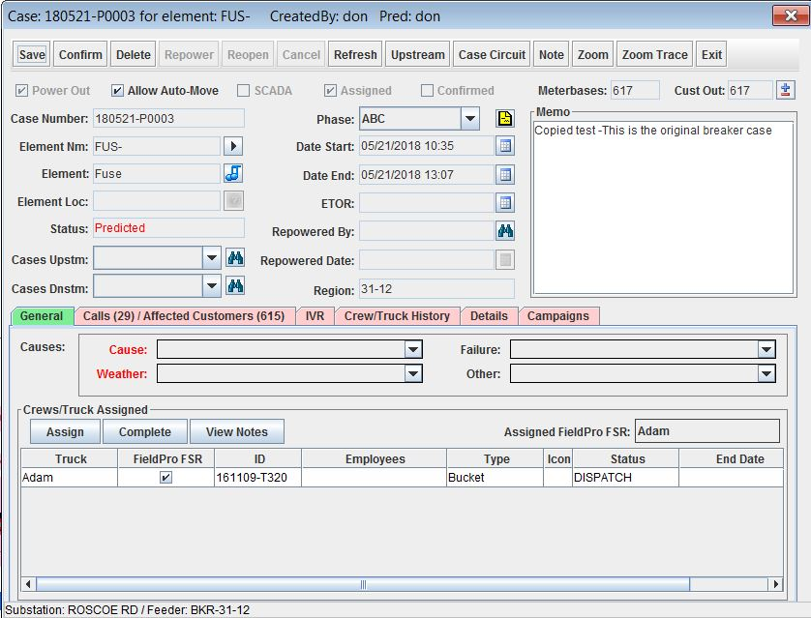
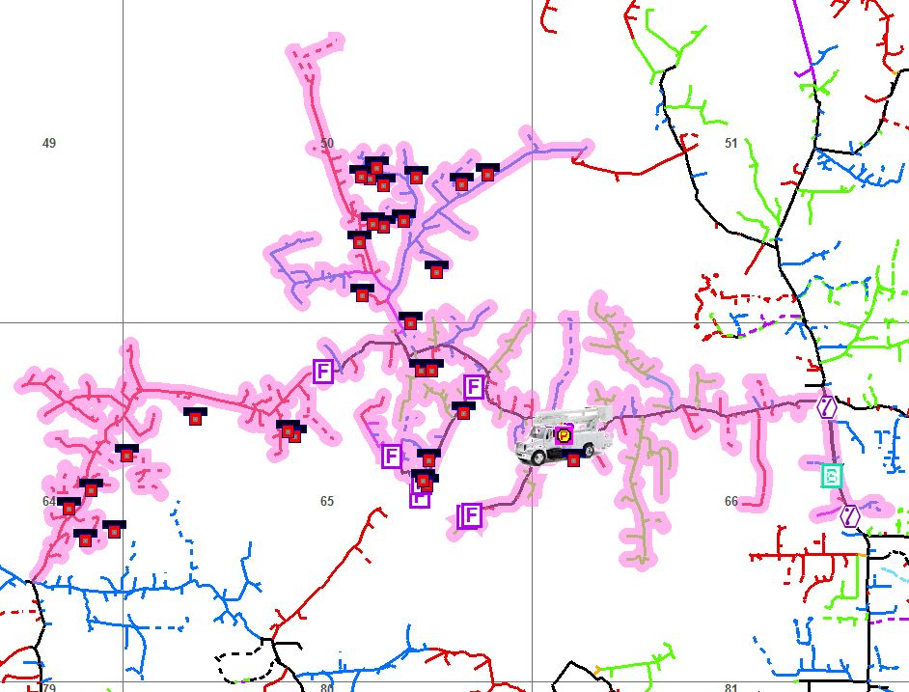
Partial Restore
Notes:
Now we can open the upline Breaker case and go ahead an restore it.
[CLICK] The result is a case on the downstream three phase Fuse. NOTE: I have left the trace from the original upline Breaker so we can see the difference.
Initially we had 33 calls predicting 848 affected customers on a Breaker.
[CLICK] Now we see that there are 29 calls predicting 615 affected customers out. Also, please note that I have transferred the assignment, and notes to this new case.
What happens to the database in the background? The difference in affected customers will be calculated automatically in the background. If you have ever seen a report with a fractional calculated number for numbers of customers out it is because the database is smart enough to know the two cases are related and it will make the calculations for you.
You can continue in this same manner device by device or even on line sections until the outage is completely resolved.
You can also account for phases within this method simply by [CLICK] adjusting the phase for the resulting outages.

Slide 19
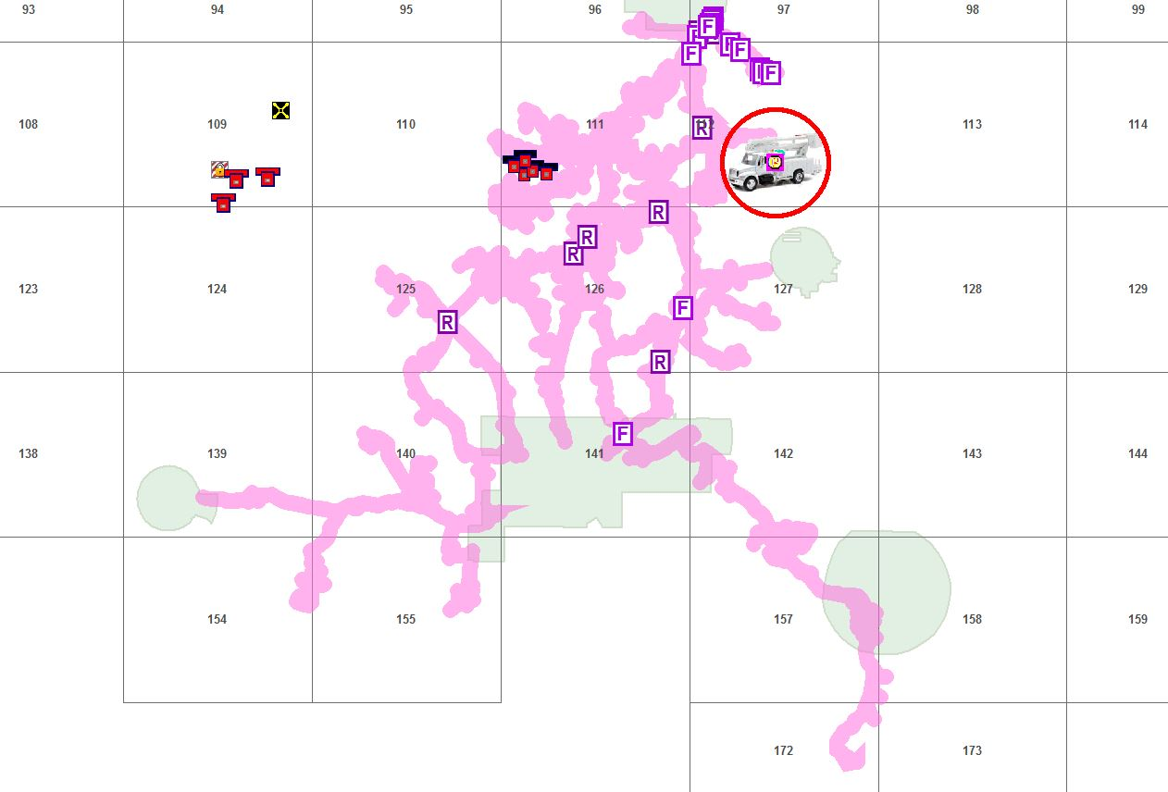
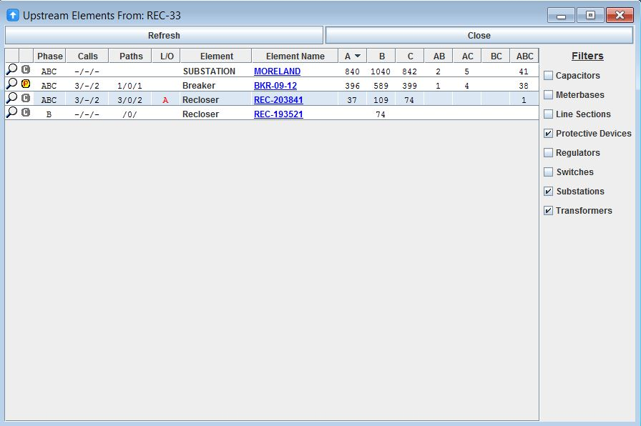
Forcing Partially Upstream
Notes:
As you move through adjusting outages downstream there will sometimes be instances when the process you use will force the case too far downstream. In these instances you will need to move them back up stream to a convenient location in order to keep the outage accurate.
[CLICK] Here we can see a Breaker outage case that was created after merging an false Breaker case with an existing downline Recloser case. We want to move this back downstream.
[CLICK] The easiest way to identify our Recloser is to open the case and click on the Upstream tool. Here [CLICK] we can see the Recloser that we need to move the case to. We can make a note of this recloser for us later in the process.

Slide 20
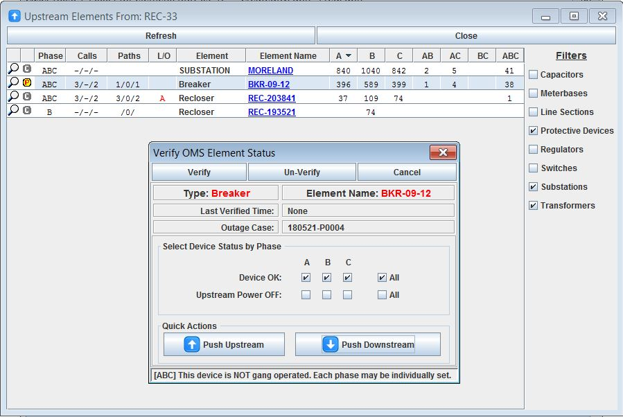
Forcing Partially Upstream
Notes:
Now we can select {CLICK} the Breaker and choose to verify downstream.
[CLICK] This is our Breaker that we will select.
[CLICK] To select Push Downstream
[CLICK] and then Verify

Slide 21
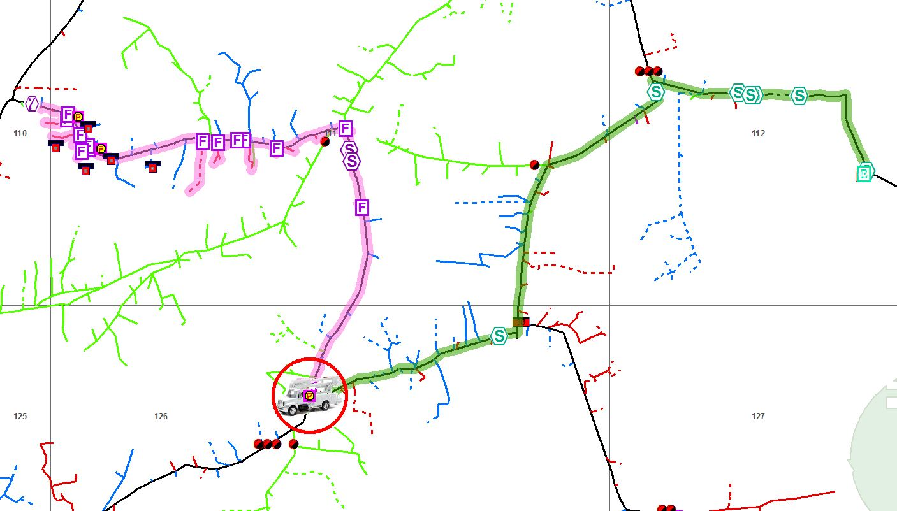
Forcing Partially Upstream
Notes:
As you can see once the {CLICK} Verify happens we now have three cases…
- {CLICK} Two downstream and…one
Which is what we want on the Recloser here…
-{CLICK}
This means we need to take these cases back up partially to get to the Recloser.

Slide 22
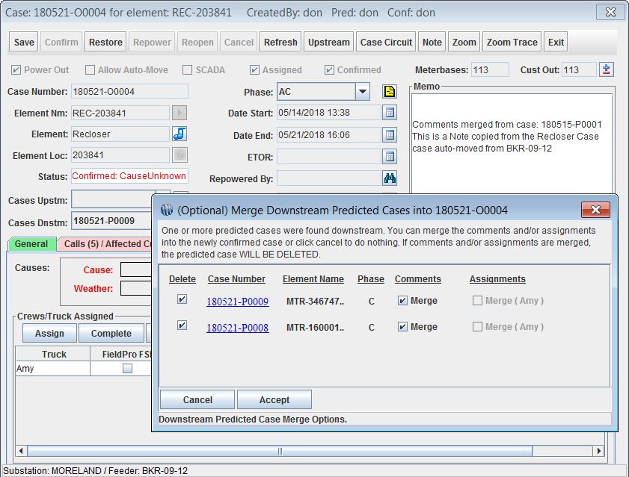
Forcing Partially Upstream
Notes:
The easiest way to do this is to open the {CLICK} Case at the Recloser and set the phase to AC in order to capture the downline C phase cases in to the Recloser A phase.
Here we can see how to do this. [CLICK] Once we change the Phase here and confirm….
{CLICK} We get the Merge pop-up where we will want to Accept and delete the other two cases.

Slide 23
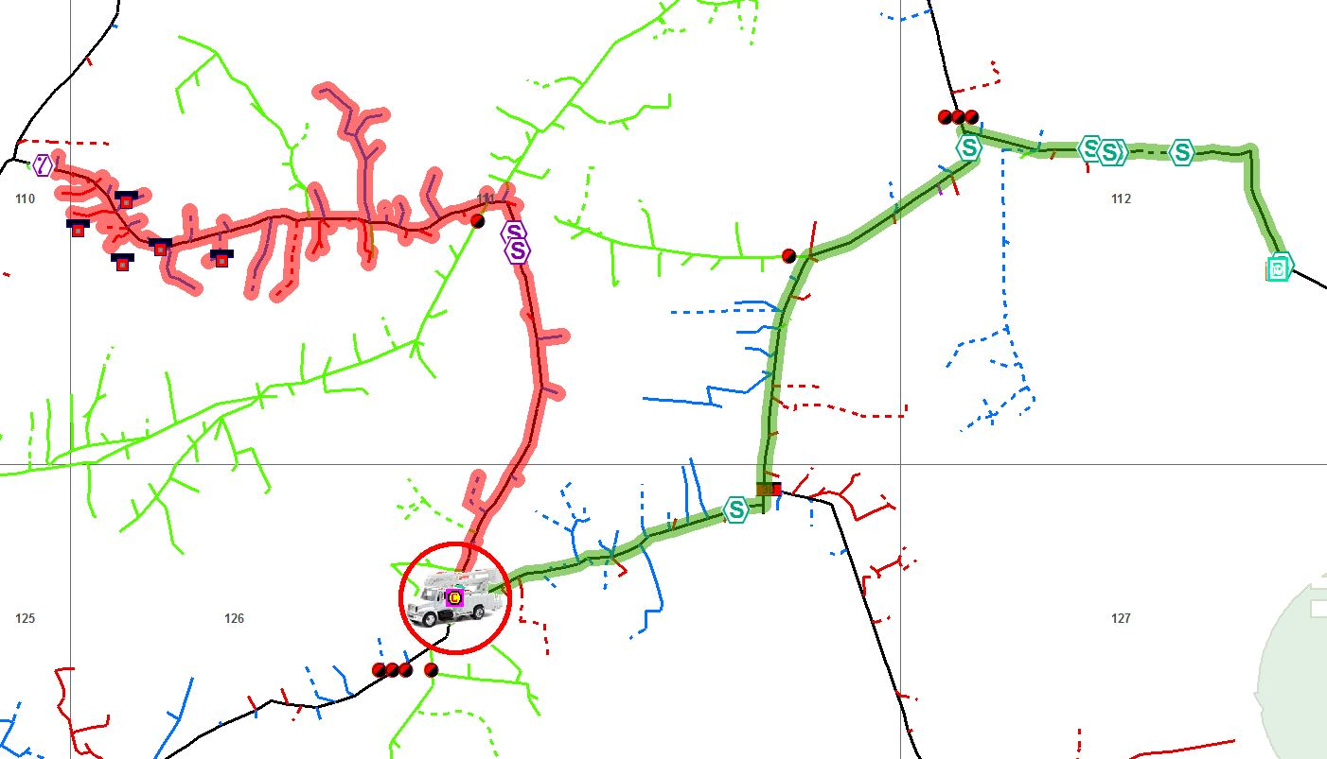
Forcing Partially Upstream
Notes:
{CLICK} Now we can see that after the merge we have a Recloser Case that is Confirmed.

Slide 24

Ensuring Data Transfers
Set Verify Time
Copy and Paste
Merge
Double Check
Notes:
We will want to make sure and take special care when using the techniques that our data is transferred from an originating case and makes it all the way to the final case. We can make these transfers happen by using the following processes:
- {CLICK} You will need to do some pre-planning especially during a large outage but you will want to set the Verify Good Time to a reasonable time-frame in order to keep the outage Case where you place it. During normal operations the standard is 15-20 minutes but in a major outage you could have this set to 24-48 hours or more while devices get back on-line.
[CLICK] Copy and Paste should be used whenever we are having to build an entirely new case and deleting the originating case.
[CLICK] Merge can be used when we have in-line cases and are presented the merge option.
[CLICK] Finally, make sure that you double-check each and every data point so that you do not loose any information.

Slide 25
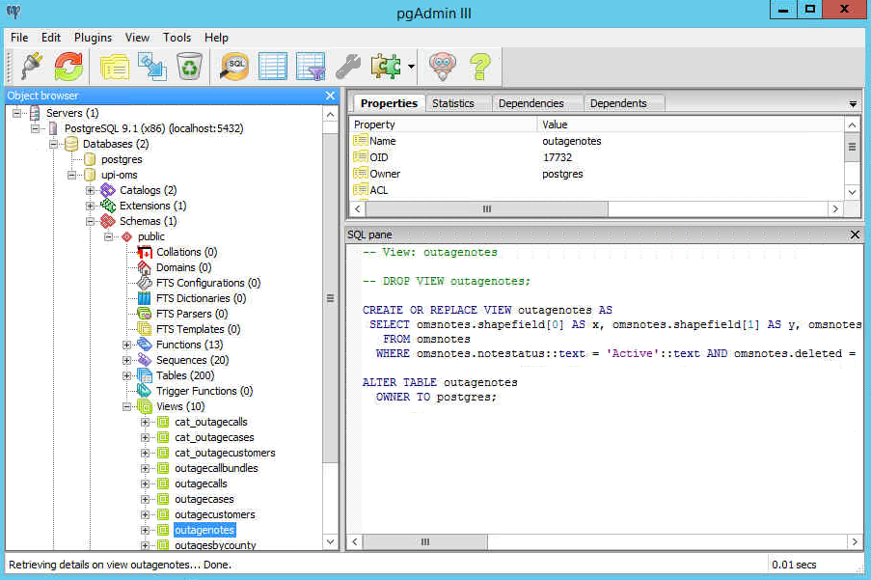
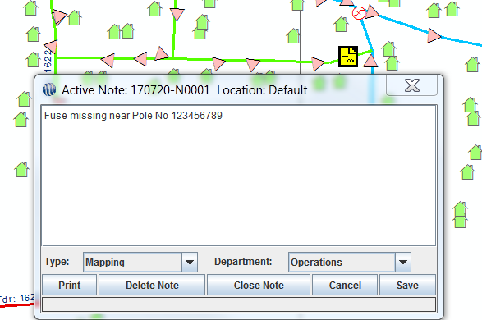
Missing Device Information in to GIS
Notes:
Because OMS and GIS are two separate databases we cannot have a direct link going back from one to the other. But there are times that OMS dispatchers receive information for missing devices, wrong phasing, wrong ID, etc.. We have the missing device report but it requires a more of an after-action style of getting the data to OMS. There has to be a better, more real-time way that doesn’t require a lot of manual effort.
Enter Notes to GIS.
[CLICK] Within every install of OMS Server buried deep inside Postgres within the views is a simple table view called outagenotes. This view contains all of the active notes added to the OMS system along with an X/Y coordinate pair.
[CLICK] In OMS within the Map tab we can select the Notes tool and add a map anywhere on the map. Here I added a Mapping note assigned to Operations and identified a missing Fuse at Pole Number 123456789. I should note that out of the box OMS does NOT have a setting for Note Type of Mapping but OMS Support can get this set up for you, just call any of us.

Slide 26
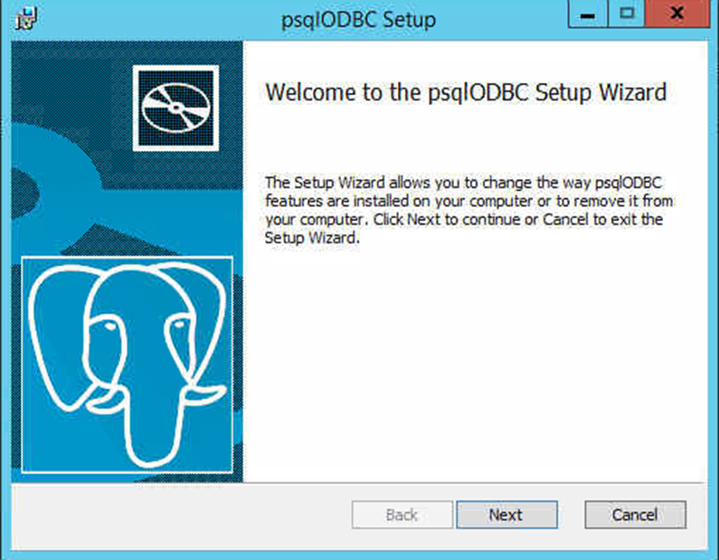
Installing Drivers
ODBC Driver
\\{OMS Server}\Deployment\Postgres
32 bit Version
Install the Postgres ODBC Driver
Notes:
Within GIS we simply set up an ODBC connection to pull in the view outagenotes as an X/Y event layer that will automatically update inside of GIS when a dispatcher makes changes within OMS. In order to set this up you will need to set up an ODBC connection on your mapping computer in order to talk to the Postgres Database and the following requirements must be met and these steps will need to be taken:
[CLICK] Open Database Connectivity (ODBC) is an open standard application programming interface (API) for accessing a database. By using ODBC statements in a program, you can access files in a number of different databases, including Access, dBase, DB2, Excel, and Text but in our specific case it will be Postgres.
[CLICK] You can find the driver located at on your OMS Server under the Deployment folder in the Postgres folder. The driver used will need to be compatible with the version od Postgres running at your coop. Since we have clients from may years ago up until as late as next week, there could be descepancies in versioning and it would be best to give us a call at OMS support and allow a day’s headway for us to allign the needed resources and verify compatibility.
[CLICK] If there are two drivers located there one will be a 32bit and the other will be a 64 bit. Because ESRI ArcMap and ArcEngine runs in a 32 bit environment you will need to install the 32 bit version. The 64 bit version is for ArcServer and will not play a part in this process.
[CLICK] You will follow the install defaults and it should only take a few seconds to finish the install.

Slide 27
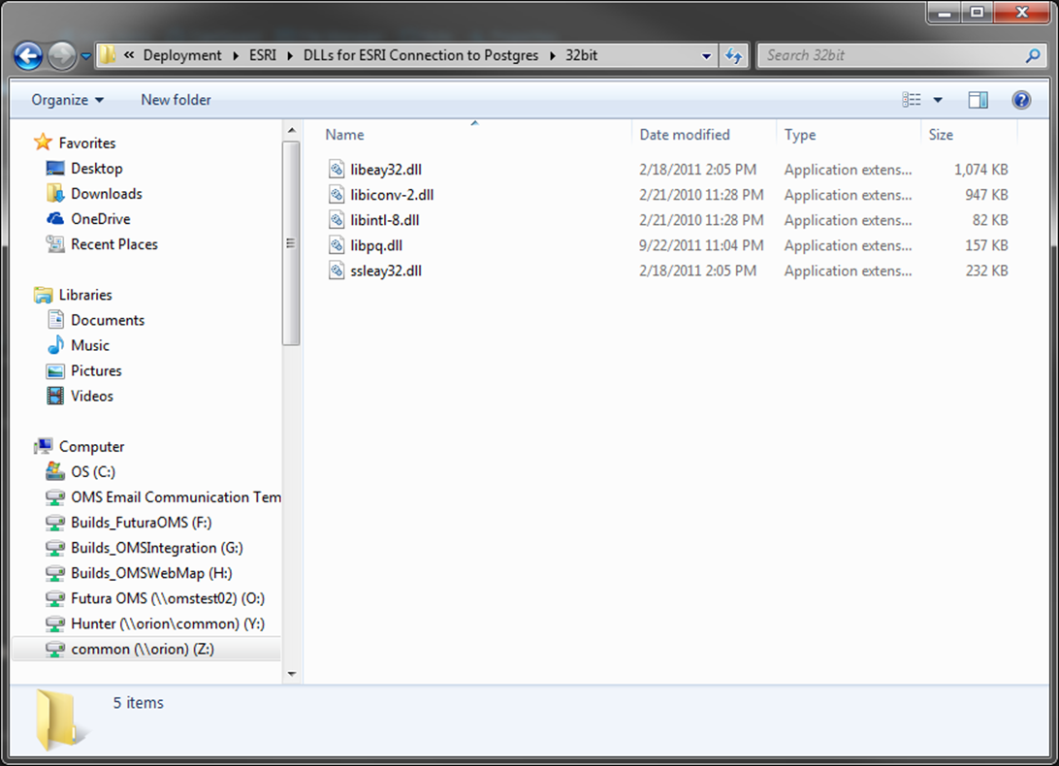
Installing Drivers
DLLs for ESRI Connection to Postgres
\\{OMS Server}\Deployment\ESRI\DLLs for ESRI Connection to Postgres\32bit
Copy and Paste the 5 32-bit .dll’s into ArcGIS bin on the local machine.
C:\Program Files (x86)\ArcGIS\Desktop10.2\bin
Notes:
Next, we will need to install a few drivers for the ESRI connection to Postgres. <<click>>
Navigate to the Deployment file share on your OMS server and check within the ESRI directory. <<click>>
There should be a directory called “DLLs for ESRI Connection to Postgres”. You will look for the DLL’s in the 32-bit folder.
<<click>>
Copy and paste the 5 .dll’s from that folder into your ArcGIS Bin directory on your local machine.
<<click>>
That directory usually looks something like this.

Slide 28
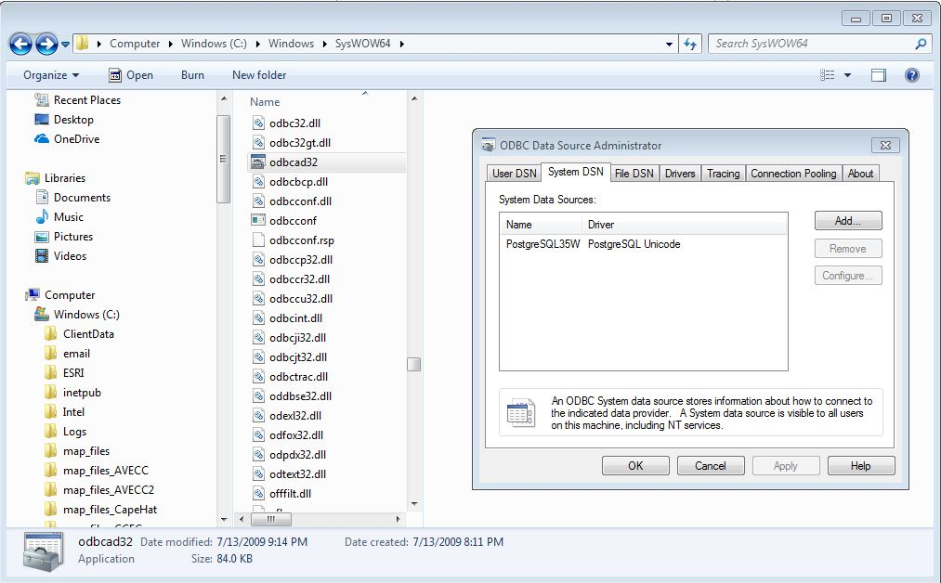
Setting Up Connections
C:\Windows\SysWOW64
odbc32 application
Notes:
Once the Postgres ODBC driver is installed on your local mapping computer we can continue to set up the connection to Postgres.
We will open windows explorer and [CLICK] navigate to the C:\Windows\SysWOW64 folder and then find
[CLICK] the odbcad32 application, this this is the 32 bit ODBC driver. If you use the control panel to access the ODBC setup you will not see your Postgres option because that setup is for 64 bit drivers not the 32 bit drivers we must use here as we have already discussed.
[CLICK] Here we can see where we have navigated to the Syswow64 folder and found the odbccad32 application and opened it. Further we are on the System DSN tab to set this connection up as it will allow everyone who logs on to this computer with a valid set of credentials to access the ODBC connection, this is important and you do not want to miss this step.

Slide 29
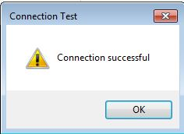
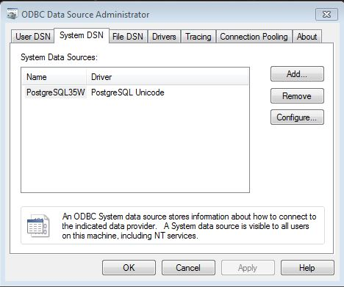
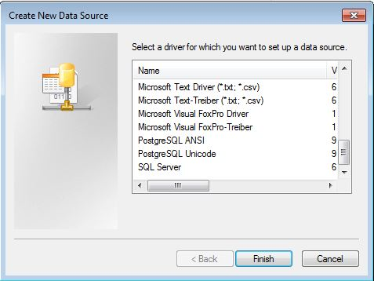
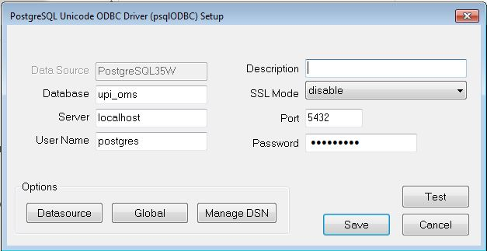
Setting Up Connections
Notes:
Once we have the ODBC setup application open and ensure that we are on the DSN tab we will….
[CLICK] click on the ADD button in order to create a new data source
[CLICK] this will open the Create New Data Source dialog where we will…
[CLICK] scroll down to the PostgresSQL Unicode driver
[CLICK] and click on the Finish button which will….
[CLICK] open the connection information dialog where we will enter:
[CLICK] Database name of your postgres OMS database, usually this is three letter designation of your utility name, a dash, and ‘oms’. Please note this will always be all lower case with no spaces.
[CLICK] Next we will enter the OMS server name or the IP address of this server
[CLICK] Rounding out the setup we have the user name of the postgres login
[CLICK] And the password of the postgres login. If you need any of this information you can contact OMS support and we can gather this for you.
[CLICK] Now we will test the connection to ensure we have the data entered correctly and….
[CLICK] finally, we click the SAVE button to commit our changes

Slide 30
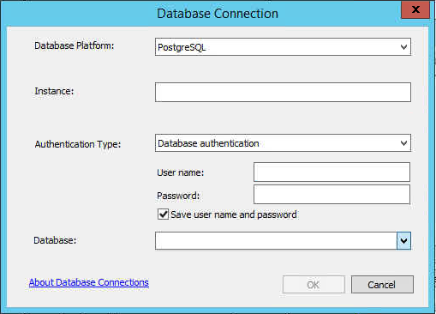
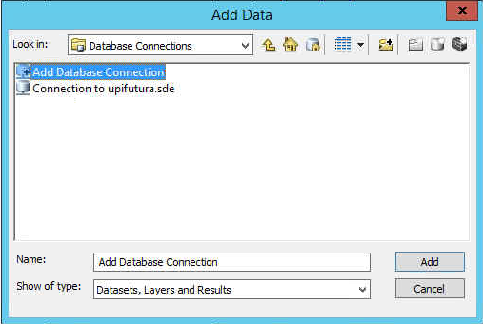
Setting Up Connections
Notes:
Now that we have the ODBC connection established and tested we can open ArcGIS to our main edit map MXD. This map is usually notated with the coop name is some incarnation and the word operations. We just want to be sure that the MXD we open is the one that is used to edit the enterprise SDE database. Once we establish these parameters we will:
[CLICK] Open the Add Data dialog by clicking on the Add Data tool once we do that…
[CLICK] The Add Data connection interface will pop-up where we will….
[CLICK] Click on the ‘Add Database Connection” option
[CLICK] And then click on the ‘Add” button
[CLICK] which will bring up the Database Connection dialog where we will:
[CLICK] Select the Database Platform, in this case we will choose PostgresSQL from the drop down list
[CLICK] Enter the instance which is the name or IP address of your OMS Server
[CLICK] Ensure that we have “Database Authentication” selected here
[CLICK] Enter the Username and password for the Postgres database
[CLICK] Select the name of the database from the drop down list
[CLICK] And finally we will click “OK” to commit this connection

Slide 31
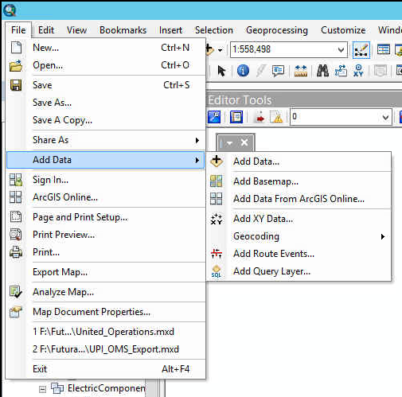
Adding XY Data
Notes:
Let’s take a quick recap of our steps thus far; we set up and established an ODBC connection to the Postgres OMS database, then we used the Add Data interface within GIS to get connected to this Postgres database.
Now we need to Add the X/Y event data to the MXD, in order to do that we need to:
[CLICK] click on the File menu and then
[CLICK] expand the Add Data module
[CLICK] so that we can access the “Add XY Data” option

Slide 32
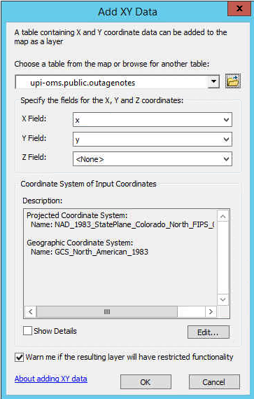
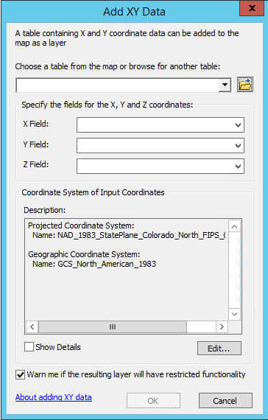
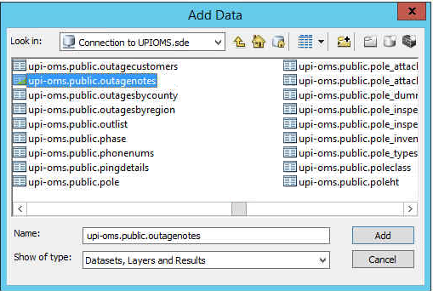
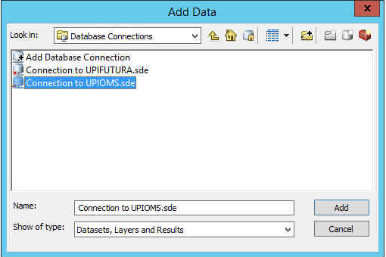
Adding XY Data
Notes:
Once we are in the Add X/Y Data interface we have to set the parameters to view the information in the map. These are straight forward and pretty easy to complete:
- [CLICK] We will use the browse button here
[CLICK] to navigate to the new connection we added, in this case it is the UPIOMS connection we want.
[CLICK] we will want to double-click on the connection name to be taken to the data selection interface.
[CLICK] where we will navigate to the table called “xxx-oms.public.outagenotes” [CLICK] where the xxx represents your coop’s three letter designation.
[CLICK] then we will click on the ADD button in order to bring this table in to the parameter in the Add X/Y Data interface.
[CLICK] Then we will continue to select the X Field
[CLICK] The Y Field
[CLICK] we will want to double-check our coordinate system to ensure we are in the correct projection
Assuming we did everything correctly up to this point we should see [CLICK] our specific parameters displayed as we entered them in our Add X/Y Data interface
[CLICK] And then we will click on the “OK” button to commit these parameters.

Slide 33
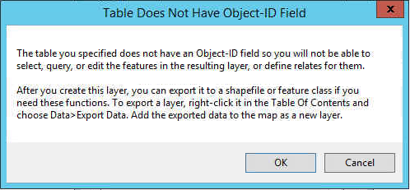
Adding XY Data
Notes:
Once we hit OK we will most likely see [CLICK] this message notifying us we do not have an Object-ID field and thus will not be able to edit, select or query in our new field. This is fine for our uses because we do not want GIS to be able to edit these, it is strictly for red-lining and will be up to OMS to edit the notes when they observe the corrections come across from GIS or when GIS notifies them that the changes have been committed to GIS.
The specifics of the business process in how your coop will proceed after GIS has corrected these issues is a matter for you to decide. We are simply showing you a tool that you can add to your toolbox to help increase accuracy in the GIS which, in turn, helps OMS to perform that much better.
- [CLICK] at this point we will click the OK button to continue and if we got everything right to this point we will see….

Slide 34
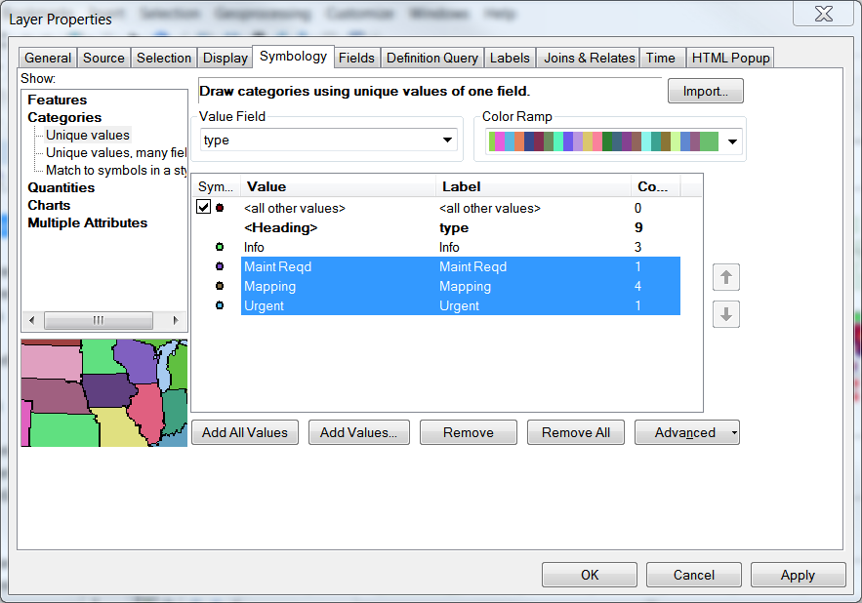






Notes to GIS
Notes:
……A new layer in our GIS Table of Contents
- [CLICK] for us this layer will be called “upi-oms.public.outagenotes”
[CLICK] and it will have all of the currently active Notes contained within OMS, this includes ones that GIS will not be concerned with
[CLICK] we can see in our table that we have a type field that we can use to filter our layer to just those with a type set to ‘Mapping’
In order to do this we will [CLICK] right-click the layer name that we just added in order to….
[CLICK] access the Properties menu item for the layer file, located here at the bottom of the pop-up menu.
[CLICK] We will now see the Layer Properties interface and once in, we may as we may as well change the layer name to something more friendly like, …….
[CLICK] oh, I don’t know, maybe ‘OMS Notes’.
[CLICK] {LASER} now let’s filter our layer to only display the Mapping notes from OMS by clicking on the Symbology tab at the top and Selecting Categories and the Unique values, we will set our Value Field to be ‘type’ and then click on the Add All Values button at the bottom.{LASER}
[CLICK] {LASER} Now we will remove the other types other than ‘Mapping’, turn off the <all other values> and set a symbol that will appear nicely on the map. Once we have the symbology as we want it and filtered properly we will commit the changes by clicking OK.

Slide 35

Notes to GIS
Notes:
Now we can see the finished product where we have the large orange eye balls on the map that GIS can query for network specific issues to be corrected in GIS.
Live demo adding XY Data and then Create a layer from cases table in OMS using XY Event Layer.

Slide 36

QUESTIONS?

Slide 37
Definitions
Call - Report of an outage
Case - Outage situation
Call Bundle: Case where outage location predicted by the OMS
Predicted: Case where outage location predicted by a user
Confirmed: Case where lineman see cause of outage
Restored: Outage repaired and power back on
Verify – Verifying device as being closed.
ODBC- Open Database Connectivity (ODBC) is an open standard application programming interface (API) for accessing a database. Allows programs to access a database.
DSN – A Data Source Name can be configured on your local machine to point to a network database. It tells your local machine where the data is located, what type of data it is, and stores the credentials needed to access it.
OMS Postgres Database – Postgres is an open source relational database management system. We use this solution for your OMS data store.
XY Event Layer - A point feature layer based on x- and y-coordinates defined in a source table.
Notes - Notes in OMS are stored in the omsnotes table in the Postgres database. Each record contains a set of X and Y coordinates and information specific to a geographic location. Customer, Case, Point on the map.
Missing Device - A missing device is a device that is in the field, that is not showing up in your GIS map or in the OMS Model. There is a specific type of note in OMS for missing devices.
Notes:
Call: report of an outage – can be from any source such as phone UPN, CRC, IVR, AMI, etc.
Case: A package for an outage situation – this includes the calls, out device, assigned crews, etc. There are 3 types of cases.
Call Bundle: case predicted by the OMS – where the software thinks that the outage is taking place based on current call evidence
Predicted: case predicted by the user – the user is reasonably confident that the outage is on a particular device and assigns a crew to respond
Confirmed: case where lineman see cause of outage – the linemen have eyes on the open device, after this status is set the outage cannot be moved to another device and OMSWebMap will display outage information if being used
Restored: outage repaired and power is back on – the linemen have repaired the open device, this will close the case out along with all associated calls in the OMS system
Verify: the act of verifying a device as being closed. Calls downstream will push the outage as far downstream as the prediction logic will allow and will split the case in to as many cases as it needs to.

